Slide 1
MNRS with QSVT – In Detail
Sharan Krishnan

Slide 2
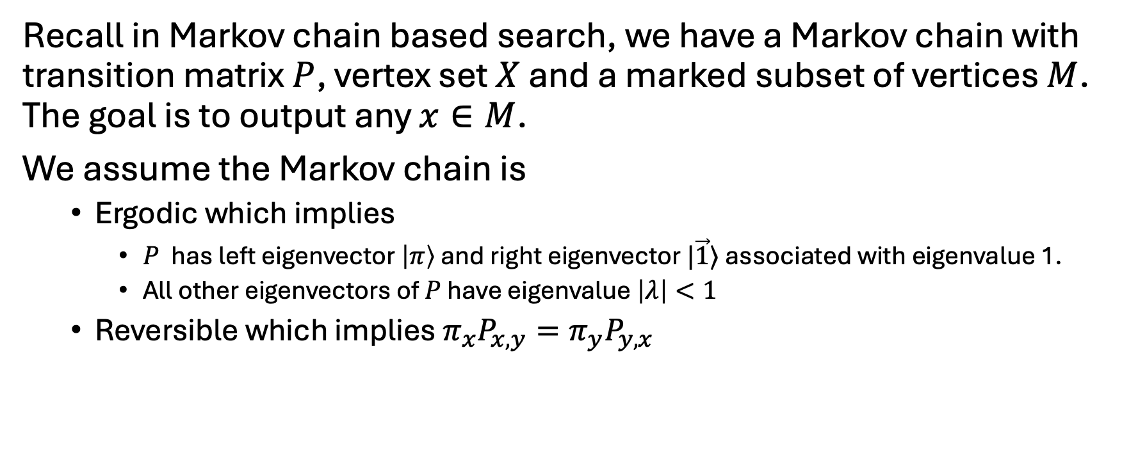
Recap of Quantum Walk Search
Recall in Markov chain based search, we have a Markov chain with transition matrix $P$, vertex set $X$ and a marked subset of vertices $M$. The goal is to output any $x∈M$.
We assume the Markov chain is
Ergodic which implies
$P$ has left eigenvector $\left|π\right\rangle$ and right eigenvector $|\vec{1}⟩$ associated with eigenvalue 1.
All other eigenvectors of $P$ have eigenvalue $\left|λ\right|<1$
Reversible which implies $π_{x}P_{x,y}=π_{y}P_{y,x}$

Slide 3
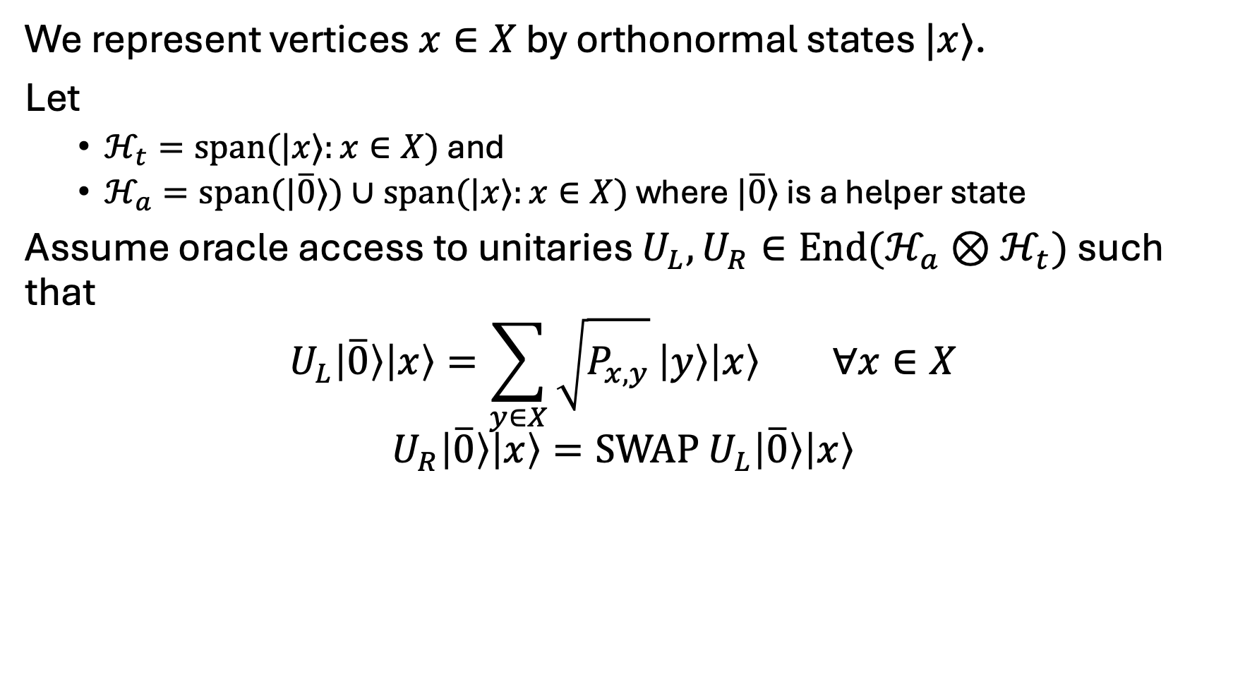
Recap of Quantum Walk Search
We represent vertices $x∈X$ by orthonormal states $|x⟩$.
Let
$ℋ_{t}=span(|x⟩:x∈X)$and
$ℋ_{a}=span(|\overline{0}⟩)∪span(|x⟩:x∈X)$ where $|\overline{0}⟩$ is a helper state
Assume oracle access to unitaries $U_{L},U_{R}∈End(ℋ_{a}⊗ℋ_{t})$ such that
$$U_{L}\left|\overline{0}\right\rangle \left|x\right\rangle =\sum_{y∈X}{\sqrt{P_{x,y}}}\left|y\right\rangle \left|x\right\rangle ∀x∈X$$
$$U_{R}\left|\overline{0}\right\rangle \left|x\right\rangle =SWAP U_{L}\left|\overline{0}\right\rangle \left|x\right\rangle$$

Slide 4
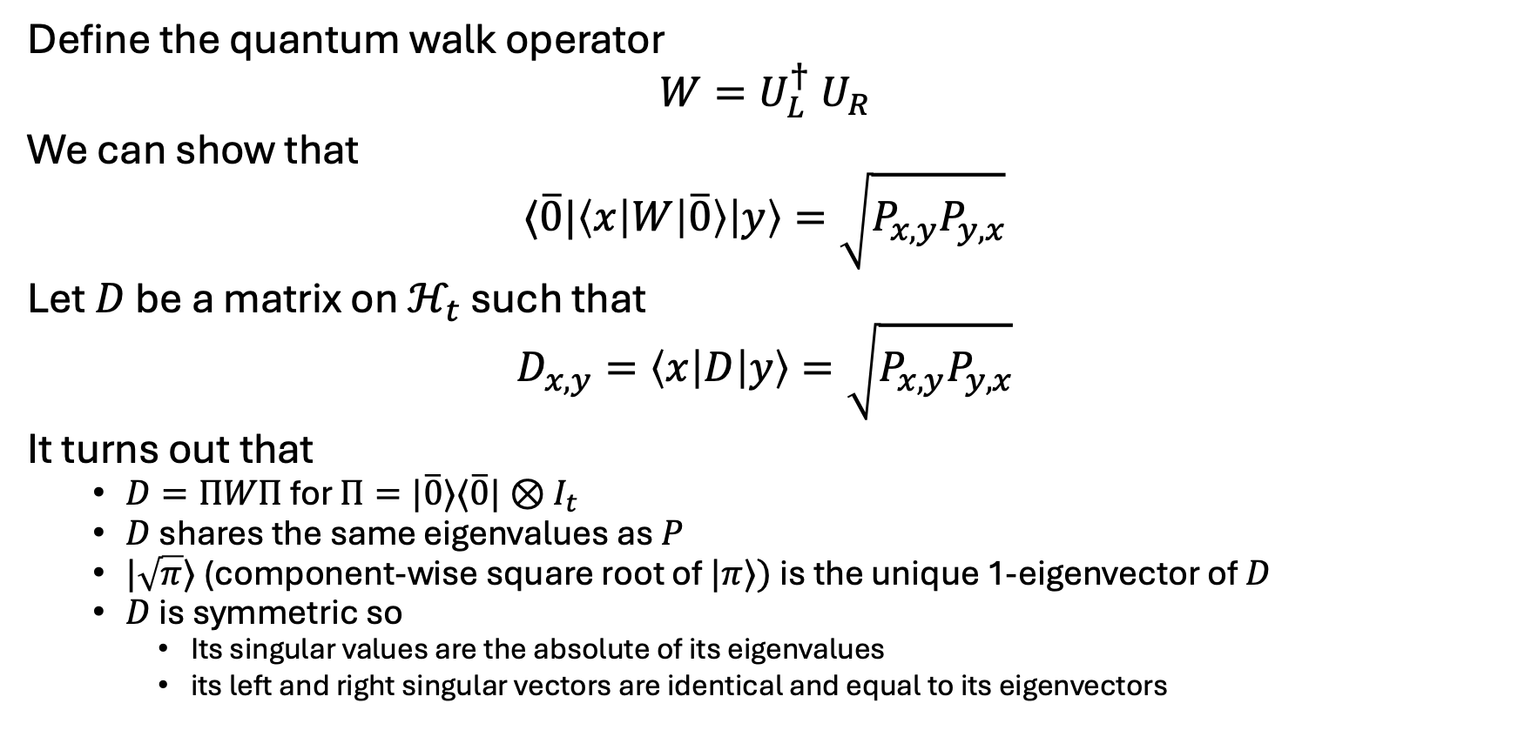
Recap of Quantum Walk Search
Define the quantum walk operator
$$W=U_{L}^{†} U_{R}$$
We can show that
$$⟨\overline{0}|\left\langle x\left|W\left|\overline{0}\right\rangle \right|y\right\rangle =\sqrt{P_{x,y}P_{y,x}}$$
Let $D$ be a matrix on$ℋ_{t}$ such that
$$D_{x,y}=\left\langle x\left|D\right|y\right\rangle =\sqrt{P_{x,y}P_{y,x}}$$
It turns out that
$D=ΠWΠ$ for $Π=|\overline{0}⟩⟨\overline{0}|⊗I_{t}$
$D$ shares the same eigenvalues as $P$
$|\sqrt{π}⟩$ (component-wise square root of $|π⟩)$ is the unique 1-eigenvector of $D$
$D$ is symmetric so
Its singular values are the absolute of its eigenvalues
its left and right singular vectors are identical and equal to its eigenvectors

Slide 5
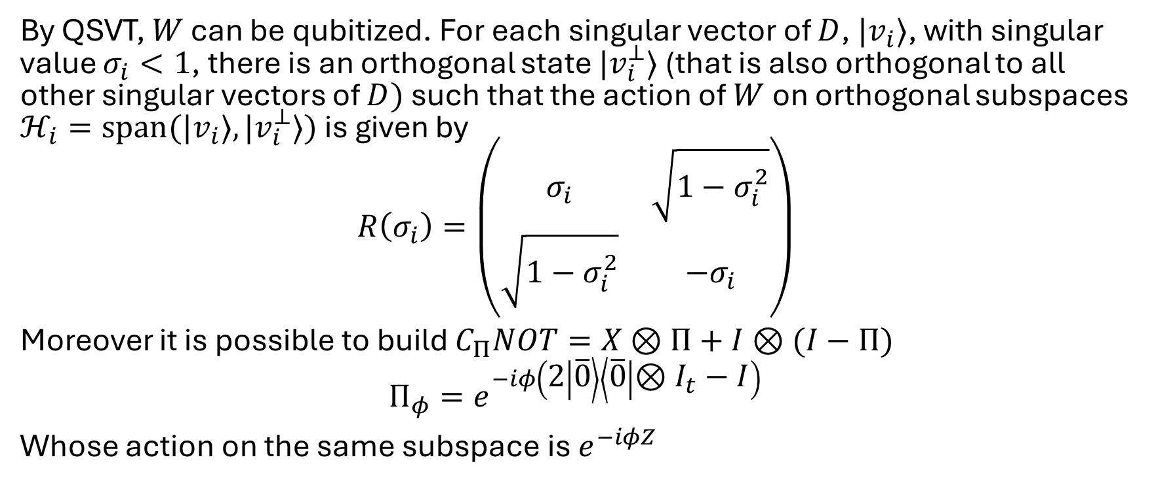
Applying QSVT
By QSVT, $W$ can be qubitized. For each singular vector of $D$, $|v_{i}⟩$, with singular value $σ_{i}<1$, there is an orthogonal state $|v_{i}^{⊥}⟩$ (that is also orthogonal to all other singular vectors of $D)$ such that the action of $W$ on orthogonal subspaces $ℋ_{i}=span(|v_{i}⟩,|v_{i}^{⊥}⟩)$ is given by
$$R\left(σ_{i}\right)=\left(\begin{matrix}σ_{i} & \sqrt{1−σ_{i}^{2}} \\ \sqrt{1−σ_{i}^{2}} & −σ_{i}\end{matrix}\right)$$
Moreover it is possible to build $C_{Π}NOT=X⊗Π+I⊗(I−Π)$
$$Π_{φ}=e^{−iφ\left(2 | \overline{0}\right\rangle \left\langle \overline{0} | ⊗I_{t}−I\right)}$$
Whose action on the same subspace is $e^{−iφZ}$

Slide 6
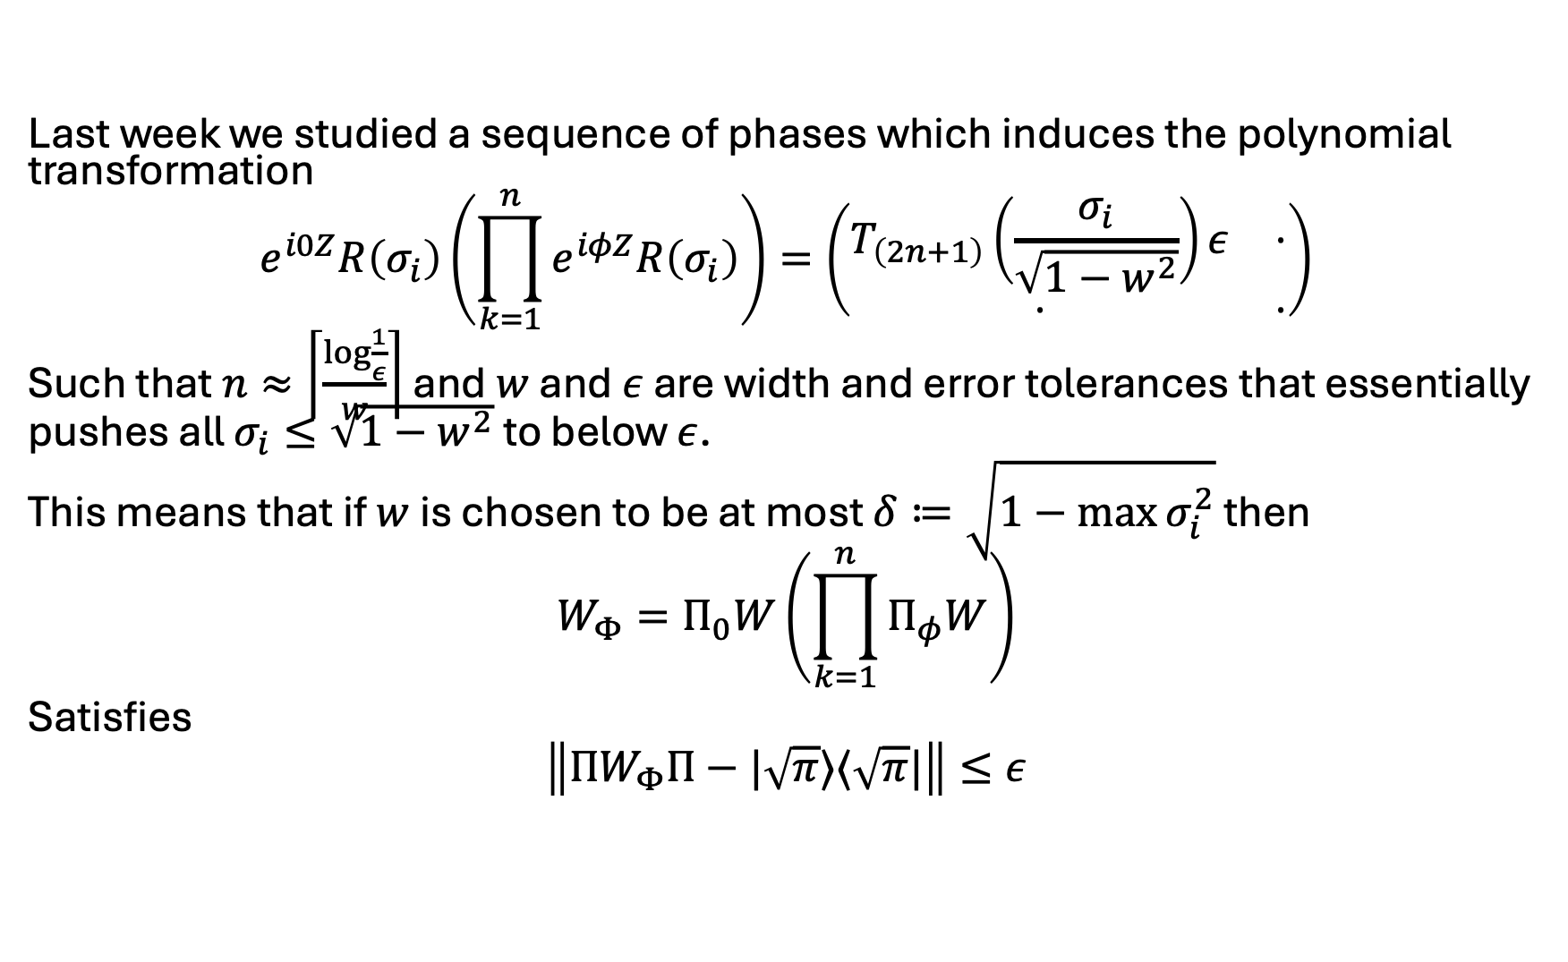
Applying QSVT
Last week we studied a sequence of phases which induces the polynomial transformation
$$e^{i0Z}R\left(σ_{i}\right)\left(\prod_{k=1}^{n}{e^{iφZ}R\left(σ_{i}\right)}\right)=\left(\begin{matrix}T_{\left(2n+1\right)}\left(\frac{σ_{i}}{\sqrt{1−w^{2}}}\right)ε & ⋅ \\ ⋅ & ⋅\end{matrix}\right)$$
Such that $n≈\left\lceil \frac{\log{\frac{1}{ε}}}{w}\right\rceil$ and $w$ and $ε$ are width and error tolerances that essentially pushes all $σ_{i}≤\sqrt{1−w^{2}}$ to below $ε$.
This means that if $w$ is chosen to be at most $δ≔\sqrt{1−\max{σ_{i}^{2}}}$ then
$$W_{Φ}=Π_{0}W\left(\prod_{k=1}^{n}{Π_{φ}W}\right)$$
Satisfies
$$\left\|ΠW_{Φ}Π−|\sqrt{π}⟩⟨\sqrt{π}|\right\|≤ε$$

Slide 7
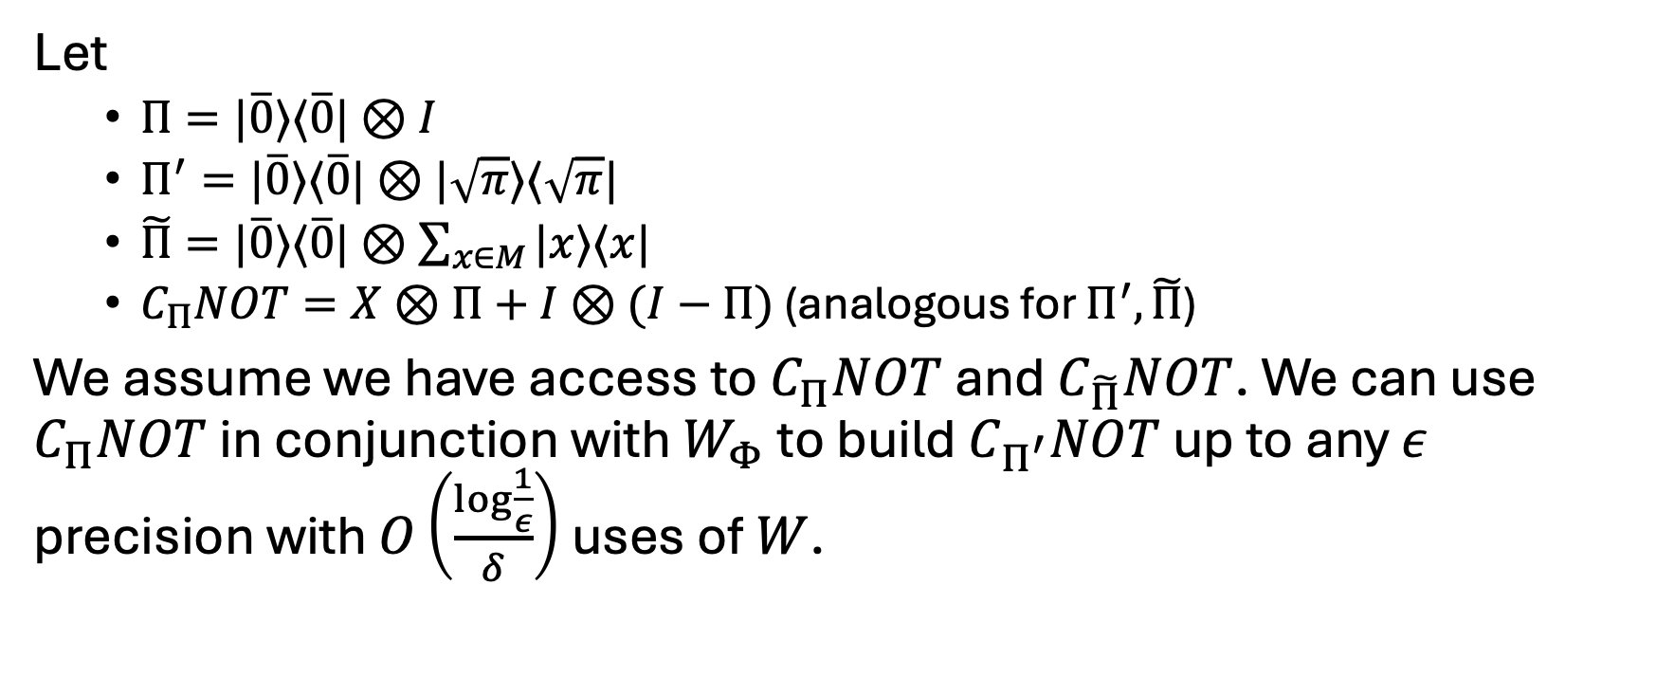
Applying QSVT
Let
$Π=|\overline{0}⟩⟨\overline{0}|⊗I$
$Π^{′}=|\overline{0}⟩⟨\overline{0}|⊗|\sqrt{π}⟩⟨\sqrt{π}|$
$\tilde{Π}=|\overline{0}⟩⟨\overline{0}|⊗\sum_{x∈M}{|x⟩⟨x|}$
$C_{Π}NOT=X⊗Π+I⊗(I−Π)$ (analogous for $Π^{′}, \tilde{Π}$)
We assume we have access to $C_{Π}NOT$ and $C_{\tilde{Π}}NOT$. We can use $C_{Π}NOT$ in conjunction with $W_{Φ}$ to build $C_{Π^{′}}NOT$ up to any $ε$ precision with $O\left(\frac{\log{\frac{1}{ε}}}{δ}\right)$ uses of $W$.

Slide 8
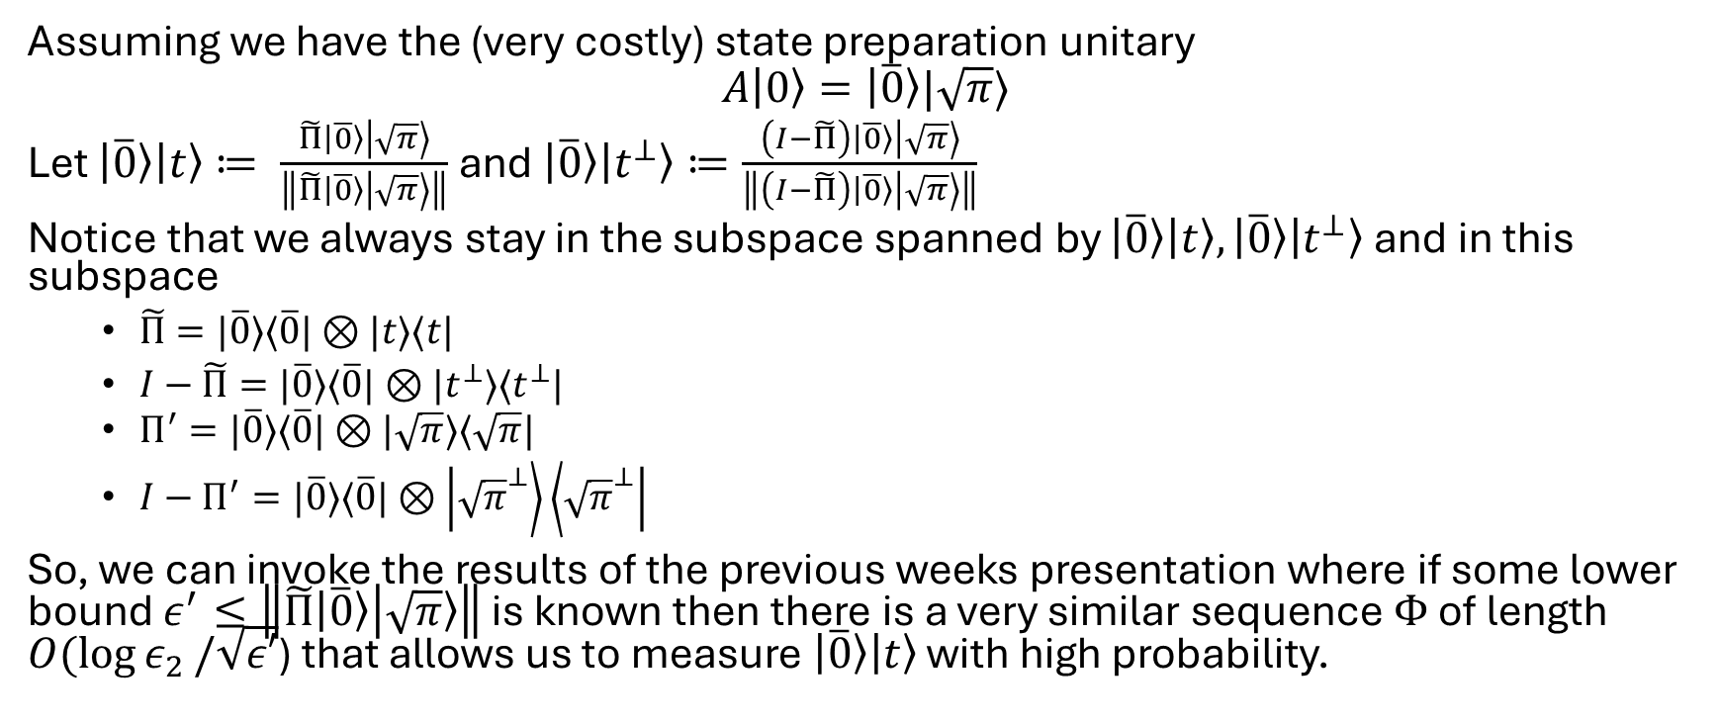
Applying QSVT
Assuming we have the (very costly) state preparation unitary
$$A\left|0\right\rangle =\left|\overline{0}\right\rangle |\sqrt{π}⟩$$
Let $\left|\overline{0}\right\rangle \left|t\right\rangle ≔ \frac{\tilde{Π}\left|\overline{0}\right\rangle \left|\sqrt{π}\right\rangle }{\left\|\tilde{Π}\left|\overline{0}\right\rangle \left|\sqrt{π}\right\rangle \right\|}$ and $\left|\overline{0}\right\rangle \left|t^{⊥}\right\rangle ≔\frac{\left(I−\tilde{Π}\right)\left|\overline{0}\right\rangle \left|\sqrt{π}\right\rangle }{\left\|\left(I−\tilde{Π}\right)\left|\overline{0}\right\rangle \left|\sqrt{π}\right\rangle \right\|}$
Notice that we always stay in the subspace spanned by $\left|\overline{0}\right\rangle \left|t\right\rangle ,\left|\overline{0}\right\rangle \left|t^{⊥}\right\rangle$ and in this subspace
$\tilde{Π}=|\overline{0}⟩⟨\overline{0}|⊗|t⟩⟨t|$
$I−\tilde{Π}=|\overline{0}⟩⟨\overline{0}|⊗|t^{⊥}⟩⟨t^{⊥}|$
$Π^{′}=|\overline{0}⟩⟨\overline{0}|⊗|\sqrt{π}⟩⟨\sqrt{π}|$
$I−Π^{′}=|\overline{0}⟩⟨\overline{0}|⊗\left|{\sqrt{π}}^{⊥}\right\rangle \left\langle {\sqrt{π}}^{⊥}\right|$
So, we can invoke the results of the previous weeks presentation where if some lower bound $ε^{′}≤\left\|\tilde{Π}\left|\overline{0}\right\rangle \left|\sqrt{π}\right\rangle \right\|$ is known then there is a very similar sequence $Φ$ of length $O(\log{ε_{2}}/\sqrt{ε′}$) that allows us to measure $\left|\overline{0}\right\rangle \left|t\right\rangle$ with high probability.

Slide 9
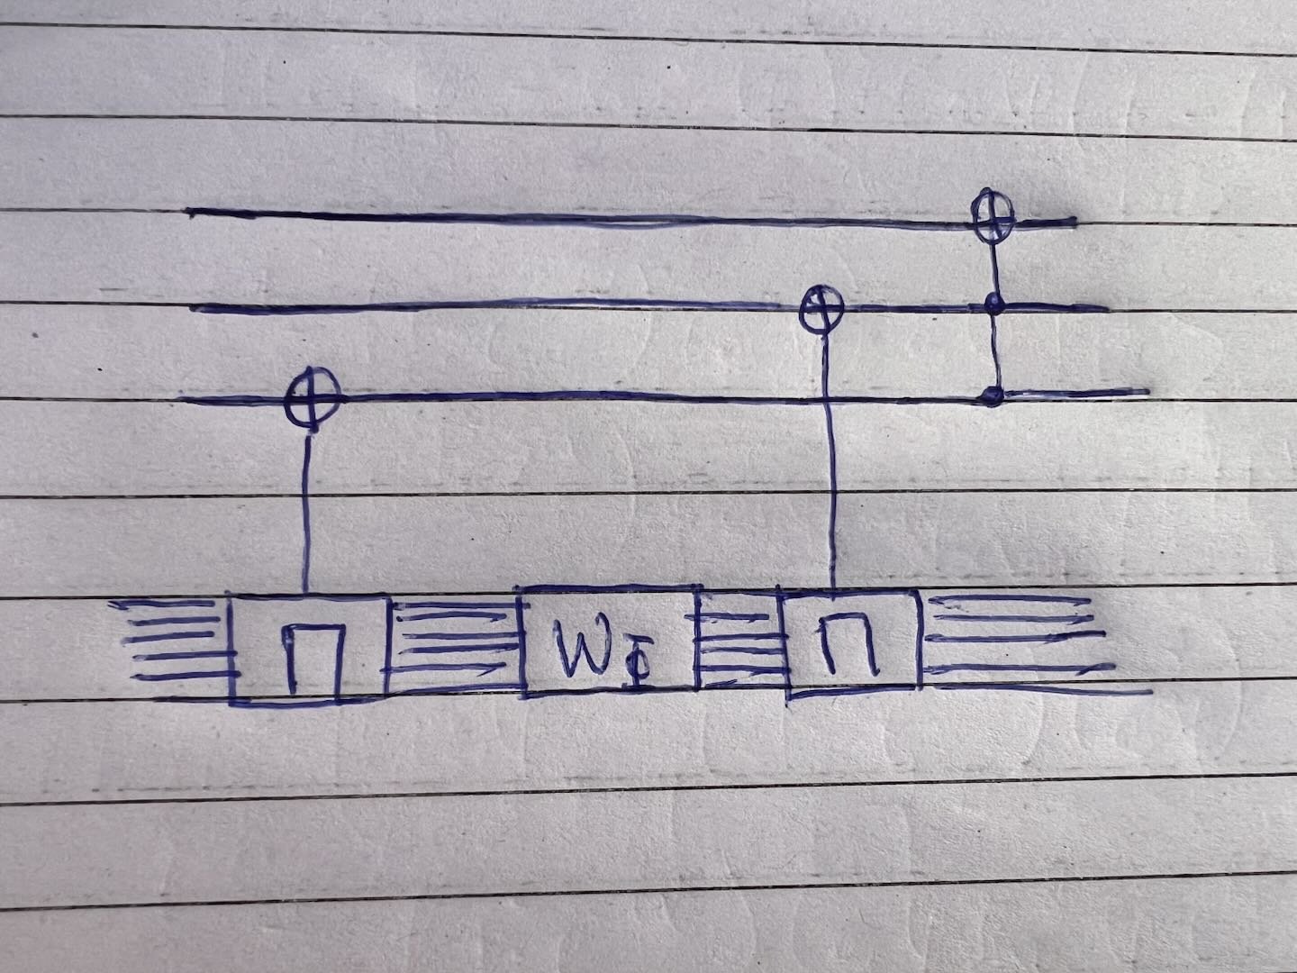

Question 1: How do we build $C_{Π^{′}}NOT$?

Slide 10
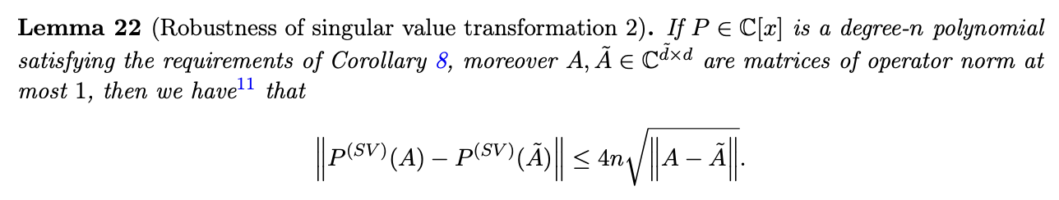
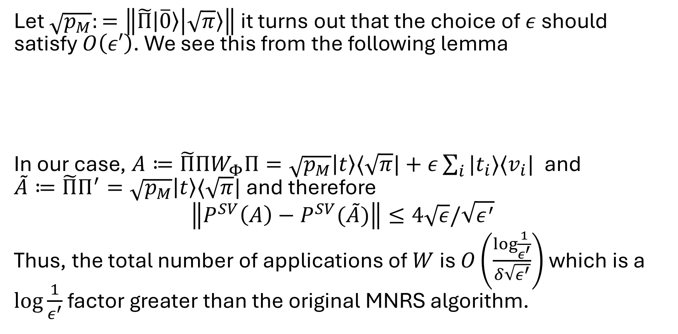

Question 2: what $ε$ should we pick?
Let $\sqrt{p_{M}}:=\left\|\tilde{Π}\left|\overline{0}\right\rangle \left|\sqrt{π}\right\rangle \right\|$ it turns out that the choice of $ε$ should satisfy $O\left(ε′\right)$. We see this from the following lemma
In our case, $A≔\tilde{Π}ΠW_{Φ}Π=\sqrt{p_{M}}\left|t\right\rangle ⟨\sqrt{π}|+ε\sum_{i}{|t_{i}⟩⟨v_{i}|}$ and $\tilde{A}≔\tilde{Π}Π^{′}=\sqrt{p_{M}}\left|t\right\rangle ⟨\sqrt{π}|$ and therefore
$$\left\|P^{SV}\left(A\right)−P^{SV}(\tilde{A})\right\|≤4\sqrt{ε}/\sqrt{ε^{′}}$$
Thus, the total number of applications of $W$ is $O\left(\frac{\log{\frac{1}{ε^{′}}}}{δ\sqrt{ε^{′}}}\right)$ which is a $\log{\frac{1}{ε^{′}}}$ factor greater than the original MNRS algorithm.

Slide 11
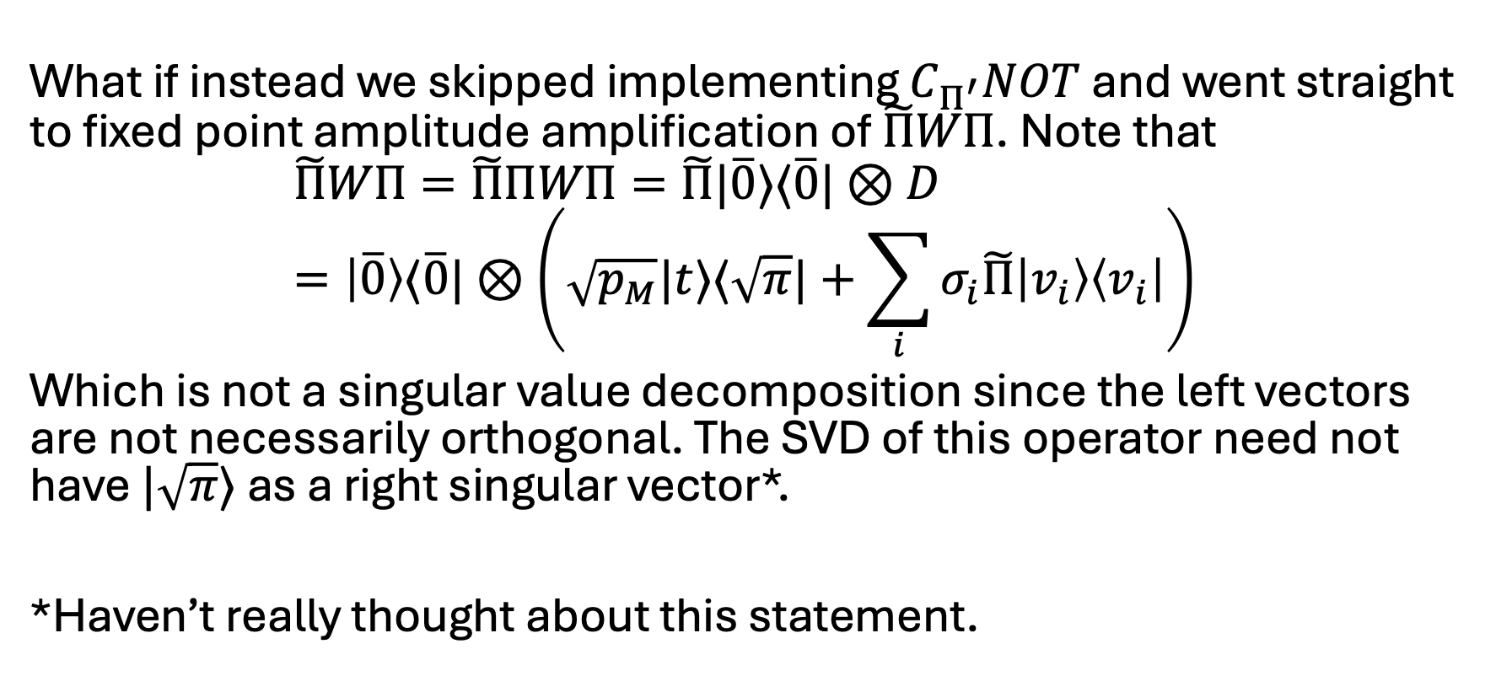

Question 3: why bother with $C_{Π^{′}}NOT$?
What if instead we skipped implementing $C_{Π^{′}}NOT$ and went straight to fixed point amplitude amplification of $\tilde{Π}WΠ$. Note that
$$\tilde{Π}WΠ=\tilde{Π}ΠWΠ=\tilde{Π}|\overline{0}⟩⟨\overline{0}|⊗D \\ =\left|\overline{0}\right\rangle ⟨\overline{0}|⊗\left(\sqrt{p_{M}}|t⟩⟨\sqrt{π}|+\sum_{i}{σ_{i}\tilde{Π}\left|v_{i}\right\rangle \left\langle v_{i}\right|}\right)$$
Which is not a singular value decomposition since the left vectors are not necessarily orthogonal. The SVD of this operator need not have $|\sqrt{π}⟩$ as a right singular vector*.
*Haven’t really thought about this statement.

Slide 12
Looking forward
While the original MNRS algorithm exceeds the QSVT implementation in efficiency, QSVT has the benefit of incorporating fixed-point oblivious search. It would be nice if we could merge these two attributes.
Dropping the log factor from the QSVT implementation of MNRS through purely QSVT techniques appears difficult as we would either need to significantly improve on Lemma 22 or adopt an approach to QSVT that deviates significantly from existing literature.
Instead, our approach should be to adapt the fixed-point oblivious search algorithm introduced by Yoder, Low and Chuang (and which is closely tied to QSVT as we saw in previous weeks) to be better related to the MNRS algorithm (which uses recursive AA) and see if we can apply similar analysis.

